Slide 1
White hat vs Black hat vs Grey hat hackers:
Hacker: An individual who uses skills to gain unauthorized access to systems and take advantages.
Black hackers: Have extensive knowledge computer system and networks bypassing security protocols also responsible for writing malwares. Their primary motivation usually for personal or financial gains.
Their activity include spreading malwares, stealing data,Not only stealing data but also modify or destroy as well which can cause very large issues
Ex: Kevin Mitnick hacked into 40 major corporations like IBM and Motorola and also US national defence warning system.

Slide 2
White hat hackers:
Use their capabilities to uncover security failings to help safe guard organizations from hackers and gets paid by contractors by working companies as security specialists. These people find gaps in security.
Activities include penetration testers specifically on finding vulnerabilities and assessing risk within system.
Ex: Tim Berners-Lee who is very famous for inventing world wide web also a member of white hat hacking camp.
Gray hat hackers:
Often look for vulnerabilities in a system with out the owner permissions. If found any loop holes reports them to the owner in exchange for financial gains, appreciation of their skills, publicity.
Companies conduct bug bounty programs to encourage Gray hat hackers.

Slide 3
Different types of attackes:
Virus: A piece of code which is capable of copying itself and typically has a detrimental effect, such as corrupting the system or destroying data.
Types of virus:
Malware: Malware is intrusive software that is designed to damage and destroy computers and computer systems. Malware is a contraction for “malicious software”.
Worms: A computer worm is a type of malware that spreads copies of itself from computer to computer. A worm can replicate itself without any human interaction, and it does not need to attach itself to a software program in order to cause damage.

Slide 4
Spyware: Malicious software designed to enter your computer device, gather data about you, and forward it to a third-party without your consent. Spyware can also refer to legitimate software that monitors your data for commercial purposes like advertising.(adware)
Trojan: Type of malware that is often disguised as legitimate software. Trojans can be employed by cyber-thieves and hackers trying to gain access to users' systems. Users are typically tricked by some form of social engineering into loading and executing Trojans on their systems.
Ransomware: Malware that employs encryption to hold a victim's information at ransom. A user or organization's critical data is encrypted so that they cannot access files, databases, or applications. A ransom is then demanded to provide access.

Slide 5
Interfaces:
Interfaces:
Can be defined as abstract type that is used to specify a behavior that all the classes must implement. Mainly used to solve the problem of multiple inherence in java.
In oops sometimes we need to define what a class does not how it does it. Here we can fully separate a class interface from its implementation this is done by the keyword interface. Once an interface is defined any number of class can implement it.
In interface we can only declare method but we cannot define it.
Ex:
public interface aeroplane{
public void seats();
}
class boing implements aeroplane{
public void seats(){
System.out.println(“25”);
}

Slide 6
Lambda in java:
Lambda: Is an anonymous function that provides a very concise and functional syntax which is further used for writing anonymous methods.
Uses of lambda:
Enable to treat functionality as a method argument, or code as data.
A function that can be created without belonging to any class.
A lambda expression can be passed around as if it was an object and executed on demand

Slide 7
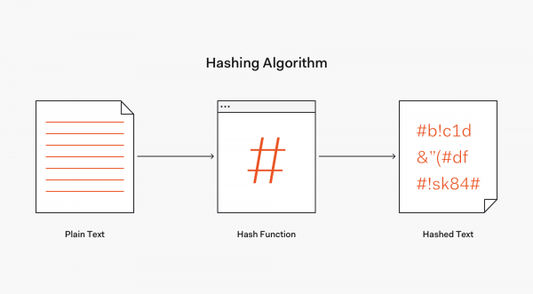
Hash
Hashing is a technique or process of mapping keys, values into the hash table by using a hash function. It is done for faster access to elements. The efficiency of mapping depends on the efficiency of the hash function used.
One main use of hashing is to compare two files for equality. Without opening two document files to compare them word-for-word, the calculated hash values of these files will allow the owner to know immediately if they are different.

Slide 8
#pragma:
The #pragma in C is a directive that is provided by the C standard in order to provide extra required details to the C compiler. These extra details can be anything that was somehow not passed within the program or the code logic. These directives, known as pragma are prefixed by the STDC in the standard.
This pragma in C carries a special purpose and is responsible for turning on or off any feature within the program. Moving ahead, we will now learn about the standard syntax for the pragma in C along with an explanation.

